Slide 1


CWCT 140
Professor David Lieberman
dlieberman@ivytech.edu

Slide 2
Agenda
Conditional Statements
Loops
Lists
Logical Operators
Bitwise Operations
Colon ( : ) operator
Shallow / Deep Copy
Programming Exercise #1

Slide 3
Python If Statement
a = 200 b = 33 if b > a: print("b is greater than a") elif a == b: print("a and b are equal") else: #the buck stops here print("a is greater than b")

Slide 4
Python If Statement
Equals: a == b
Not Equals: a != b
Less than: a < b
Less than or equal to: a <= b
Greater than: a > b
Greater than or equal to: a >= b

Slide 5
Python While Loop
i = 1 while i < 6: print(i) i = i + 1
i = 1 while i < 6: print(i) if i == 3: break i += 1
#...

Slide 6
Python Lists
thislist = [1, 5, 7, 9, 3]
print(thislist)
thislist = ["apple", "banana", "cherry"] print(thislist)

Slide 7
Python For Loop
for x in range(6): print(x)
Note that range(6) is not the values of 0 to 6, but the values 0 to 5.
for i in range(6): print(i) if i == 3: break #...

Slide 8
Python For Loop
for x in range(0, 6, 2): print(x)
Spans the range of 0 to 5 with an increment of 2.

Slide 9
Python For Loop
fruits = ["apple", "banana", "cherry"] for x in fruits: print(x)
fruits = ["apple", "banana", "cherry"] for x in fruits: print(x) if x == "banana": break

Slide 10
Python Logical Operators
and
or
not

Slide 11
Python Bitwise Operators
& AND
| OR
^ XOR
~ NOT
<< zero fill left shift
>> signed right shift

Slide 12
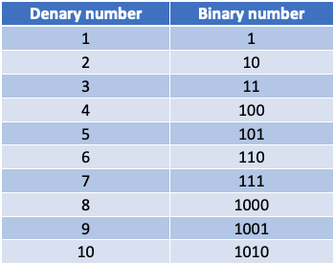
Binary Numbers

Slide 13
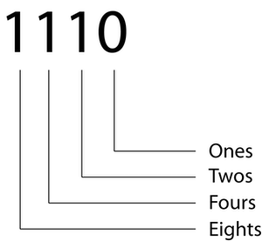
Binary Numbers
(1 * 8) + (1 * 4) + (1 * 2) + (0 * 1) = 14

Slide 14
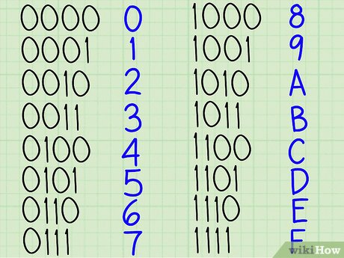
Hex to Binary
Each group of four binary digits forms a hexadecimal digit

Slide 15
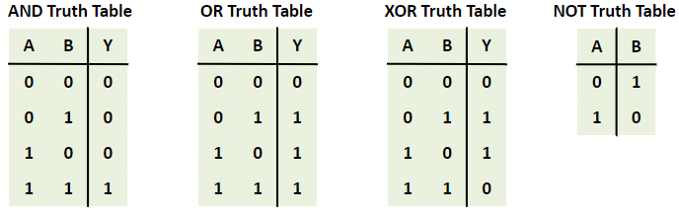
Truth Tables

Slide 16
Bitwise Operations
1 0 1 0 1 0 1 1 0xAB
AND
1 1 1 1 1 1 1 1 0xFF
-------------------
1 0 1 0 1 0 1 1
1 0 1 0 1 0 1 1 0xAB
OR
1 1 1 1 1 1 1 1 0xFF
-------------------
1 1 1 1 1 1 1 1

Slide 17
Bitwise Operations
1 0 1 0 1 0 1 1 0xAB
XOR
1 1 1 1 1 1 1 1 0xFF
-------------------
0 1 0 1 0 1 0 0
NOT 1 0 1 0 1 0 1 1 0xAB
-------------------
0 1 0 1 0 1 0 0

Slide 18
Bitwise Operations
<< 1 0 1 0 1 0 1 1 0xAB
-------------------
0 1 0 1 0 1 1 0 0x56
>> 1 0 1 0 1 0 1 1 0xAB
-------------------
0 1 0 1 0 1 0 1 0x55

Slide 19
Turn a Bit “On”
0 0 0 0 0 0 0 0
OR
0 1 0 0 0 0 1 0
-------------------
0 1 0 0 0 0 1 0

Slide 20
Turn a Bit “Off”
0 1 1 1 1 1 1 0
AND
1 0 1 1 1 1 0 1
-------------------
0 0 1 1 1 1 0 0

Slide 21
Python Lists
#Initialize a list
NumList = [73, 88, 112, 10, 5]
#Build a list
NumList = []
NumList.append(73)
NumList.append(88)
NumList.append(112)
NumList.append(10)
NumList.append(5)

Slide 22
Python Lists
NumList = [73, 88, 112, 10, 5]
#Print whole list
print(NumList)
#Print numbers in list
print(NumList[0])
print(NumList[1])
print(NumList[2])
print(NumList[3])
print(NumList[4])

Slide 23
Python Lists
NumList = [73, 88, 112, 10, 5]
#Print length of list
print(len(NumList))
#Delete element from list
del NumList[0]

Slide 24
Colon ( : ) Operator
Slices a part from a sequence object such as list, tuple or string.
It takes two arguments. First is the index of start of slice and second is index of end of slice.
Both operands are optional. If first operand is omitted, it is 0 by default. If second is omitted, it is set to end of sequence.

Slide 25
Colon ( : ) Operator
myList = ["apple", "banana", "cherry", "kiwi",
"grape", "pear", "orange"]
print(myList[0])
print(myList[0:1])
print(myList[0:2])
print(myList[-1])
print(myList[-1:])
print(myList[-2:])
print(myList[-2:-1])

Slide 26
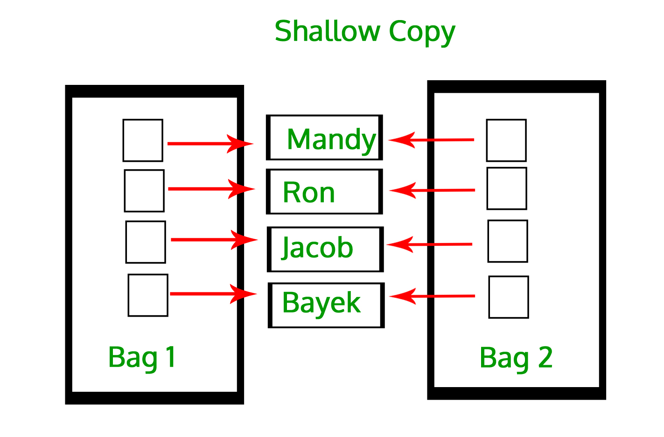
Shallow Copy
Bag1 = [1, 2, 3]
Bag2 = Bag1

Slide 27
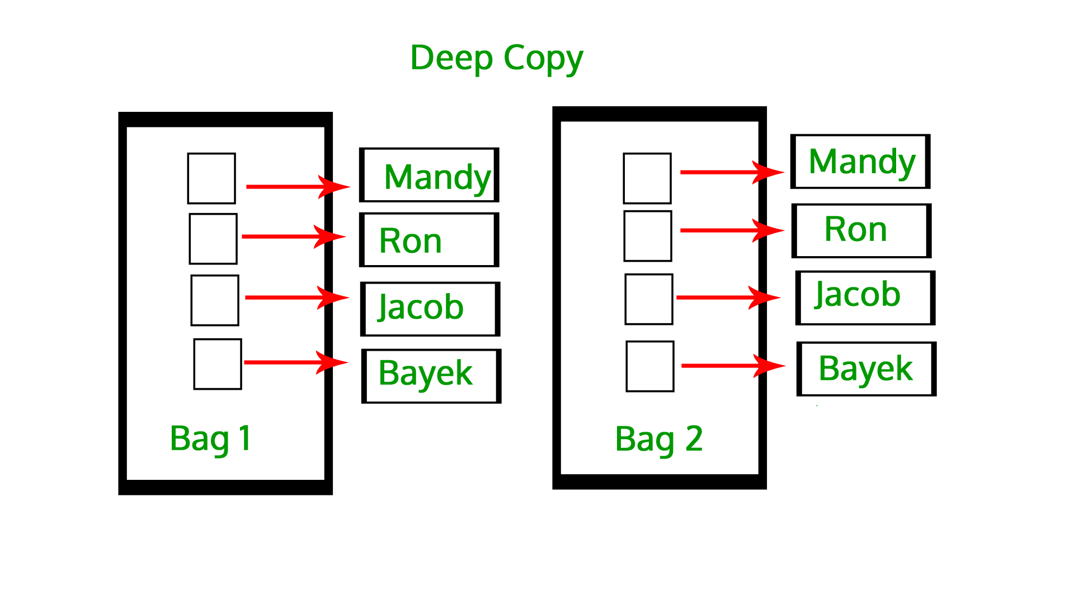
Deep Copy
Bag1 = [1, 2, 3]
#slice
Bag2 = Bag1[:]

Slide 28
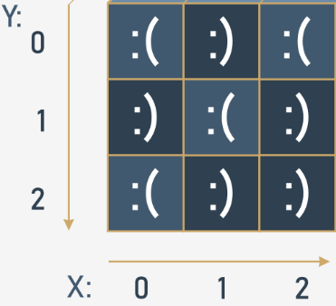
List In a List

Slide 29
Programming Assignment
With all program submissions you need to include screenshots illustrating your programs ran successfully.
All program submissions require a header comment containing your name, course, date, program name, and a description of the program.

Slide 30
Assignment #1
A triangle has three sides where the sum of the length of any (every) two of the sides must exceed the other side.
In a right triangle, the square of the length of the longest side is equal to the sum of the squares of the lengths of the other two sides.
In an isosceles triangle the length of any two of the sides must be equal.
In an equilateral triangle the length of all three sides must be equal.
Write a program that prompts the user to enter the lengths of three sides of a triangle. The program will output a message indicating:
whether or not the lengths form a triangle and, if so,
whether or not the triangle is
a right triangle,
an isosceles triangle, and/or
an equilateral triangle.
Input Validation: Do not accept a number <= 0 for any side.

Slide 31
Assignment #1
a
a
a
a
c
a
b
a
b
?
Isoceles
Equilateral
Right

